Slide 1
PREDICTION OF CANCER USING MACHINE LEARNING
NAME : PRAVEEN A
ROLL NO : 17MSS039
DEPARTMENT : MSC (SOFTWARE SYSTEMS)
GUIDE NAME : KARTHIKEYAN G

Slide 2
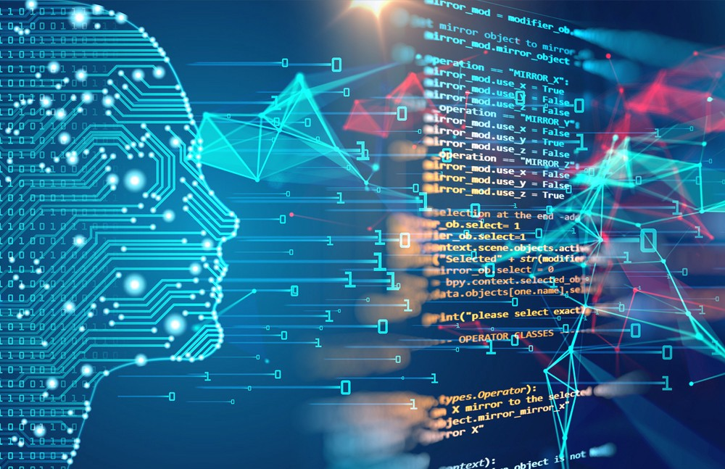
Introduction
In this project I am trying to analyze the Breast Cancer dataset to make a prediction model for predicting the Cancer disease.
This breast cancer databases was obtained from the University of Wisconsin Hospitals, Madison from Dr. William H. Wolberg.

Slide 3
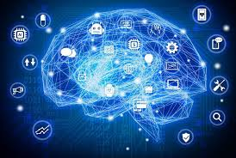
Abstract
This breast cancer data obtained from the University of Wisconsin Hospitals has 699 data.
My motive is to predict the chances of BREAST CANCER for a individual with their biological factors like Clump Thickness, Bland Chromatin , and so on.

Slide 4
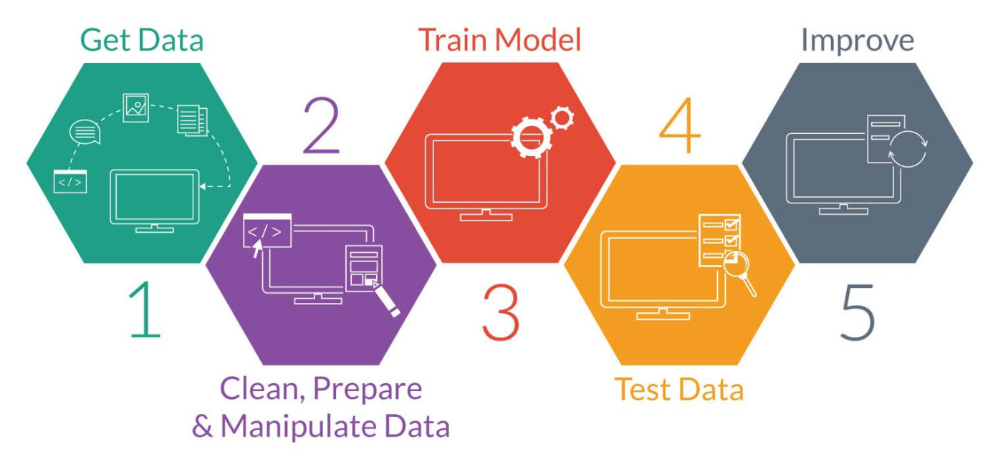
Project Overview
Initially python coding is opened in python IDLE and then program is executed .
The code will automatically collects data and perform statistical evaluation .
The data and the calculated values is represented in graphs
Then user manual inputs are entered. The output is predicted and then displayed in python shell.

Slide 5
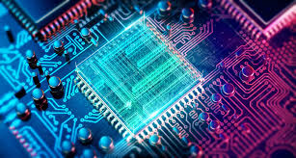
Hardware And Software Specifications
HARDWARE SPECIFICATIONS
PROCESSOR : Intel i5 Processor 7th Gen
CPU CLOCK SPEED : 1.6 GHz
RAM : 4 GB or Higher
HDD : 300 GB of available hard disk space
VIDEO CARD : NVidia GeForce GTX 940MX or Higher
SOFTWARE SPECIFICATIONS
FRONT END : HTML,CSS
BACK END : Python 3.7 (scripting),Microsoft Access 2010
OPERATING SYSTEM : Windows 10
IDLE : Python IDLE

Slide 6
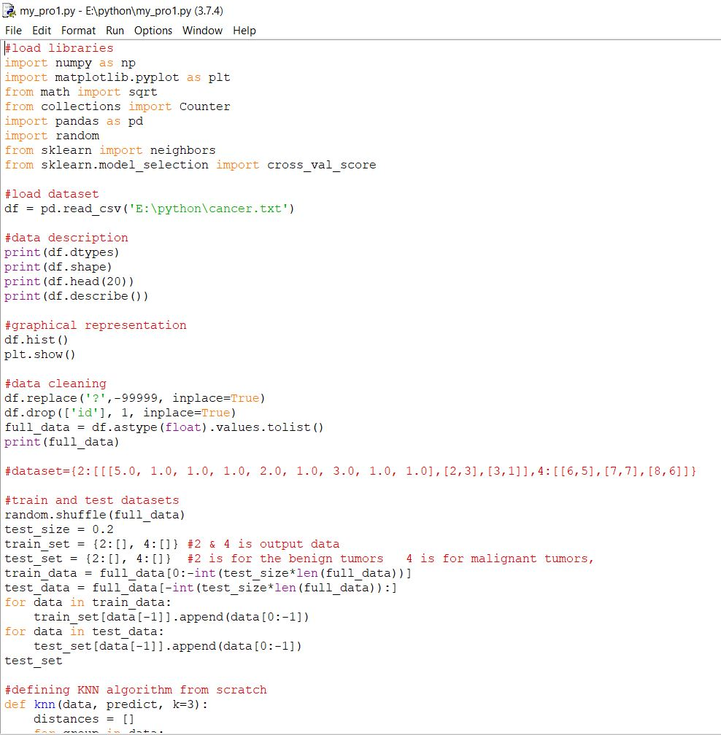
Coding Section
The proper description is given before the each and every coding line with command lines .
Most of the calculated values will be printed in the python shell . Even graphical approach is used to display the data for easy representations .

Slide 7
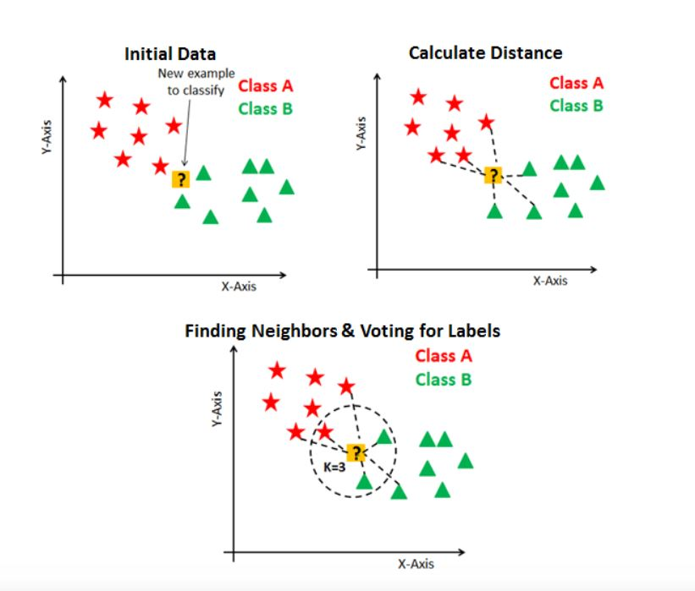

KNN Algorithm
A k-nearest-neighbor algorithm, often abbreviated k-nn, is an approach to data classification that estimates how likely a data point is to be a member of one group or the other depending on what group the data points nearest to it are in.
Distance functions
Euclidians :

Slide 8
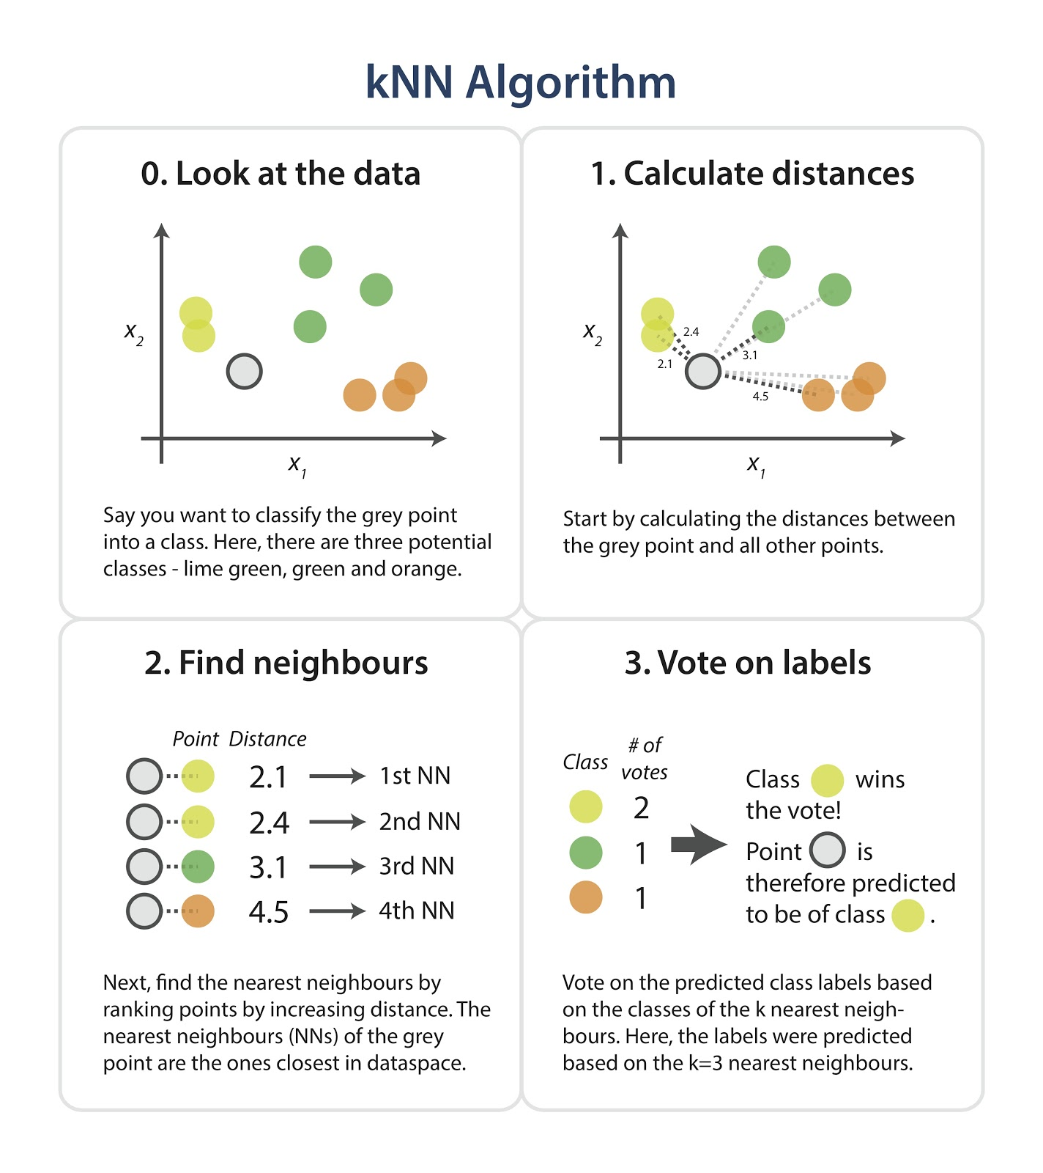

Slide 9
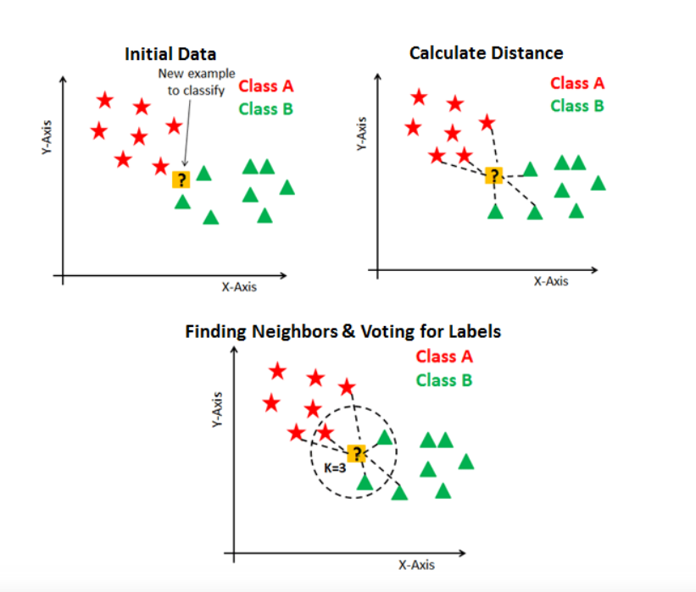

Slide 10
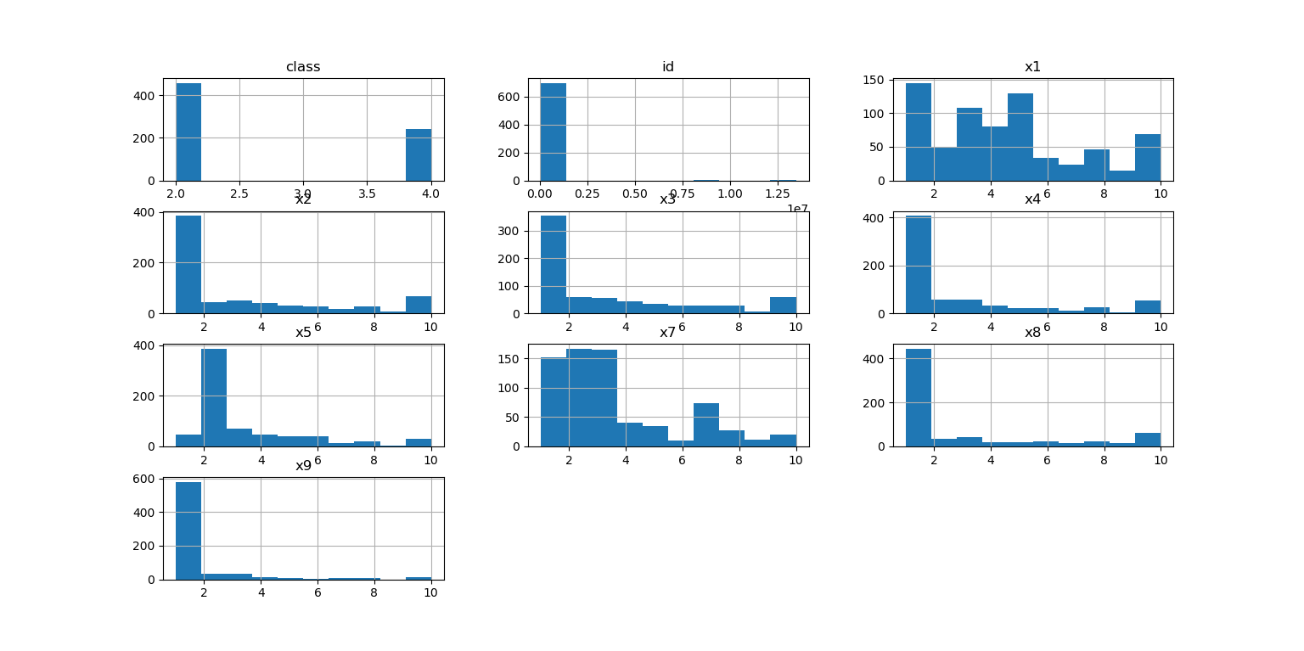
Graphical Approach
Values in dataset and the algorithm comparison are represented in graphical matter for easy understanding towards it .
The bar graph and histogram are used in this project.

Slide 11
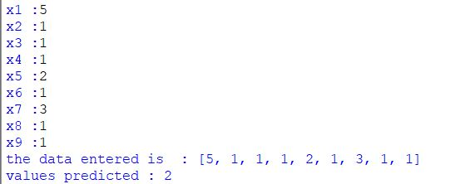
User Input
User will provide the necessary inputs through the python shell will can be in integer .
The input values will be send to the algorithm and the respected output will be displayed and the user inputs will be stored in database for future reference.

Slide 12
Table Design
The database table is created in Microsoft Access and connected with the Python.
Once the user is done with inputs in the python shell , the input values and also the predicted valued will be saved in the database for the future reference. Most of the columns will be integer or float in general.
Clump Thickness | Uniformity of Cell Shape | Uniformity of Cell Shape | Marginal Adhesion | Single Epithelial Cell Size | Bare Nuclei | Bland Chromatin | Normal Nuclei | Mitoses | Result
integer | integer | integer | integer | integer | integer | integer | integer | integer | integer (2 0r 4)
Not null | Not null | Not null | Not null | Not null | Not null | Not null | Not null | Not null | Not null

Slide 13
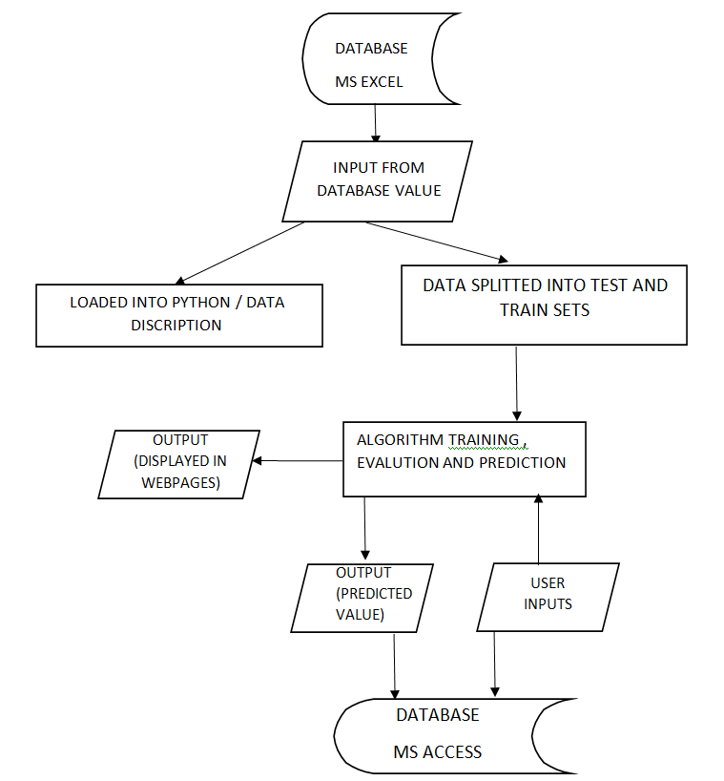
System Flow Diagram
My project has the following SFD . Each and every process , steps , input/output areas are explained clearly in the diagram .

Slide 14
THANK YOU !

